Slide 1

Automated Feedback Analysis Workflow
John Mc Daniel
AI Automation | Project 3

Slide 2
Introduction
John Mc Daniel
Project Overview:
*Build a zero-code automation that processes customer feedback
*Transform scattered feedback into clear insight
*Use AI to analyze and create automatic summaries
*Store and organize everything in Google Sheets for easy tracking

Slide 3
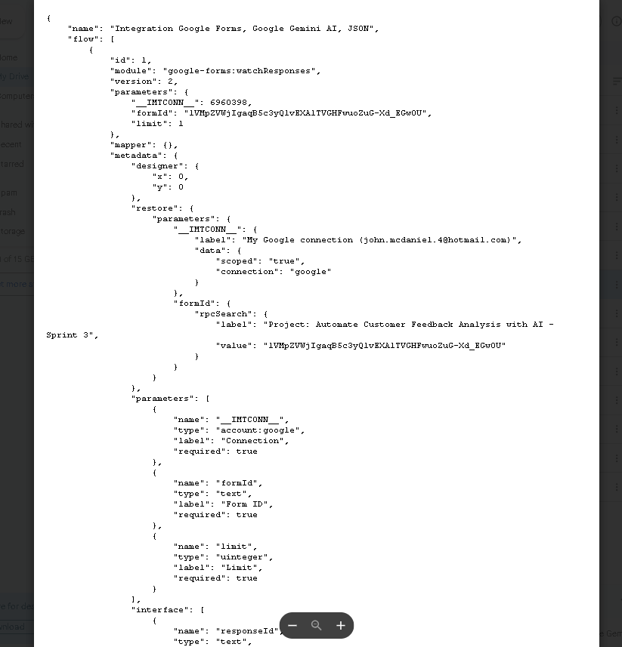
Workflow diagram - JSON
JSON Workflow Intergration Link:
https://drive.google.com/file/d/1BC4n7b9-z_vADSFhP6nUzco637n1QnyA/view?usp=sharing

Slide 4
Workflow Automation Summary
The workflow in the provided Make.com scenario below focuses on automating tasks by connecting various applications through a user-friendly visual interface.

Slide 5
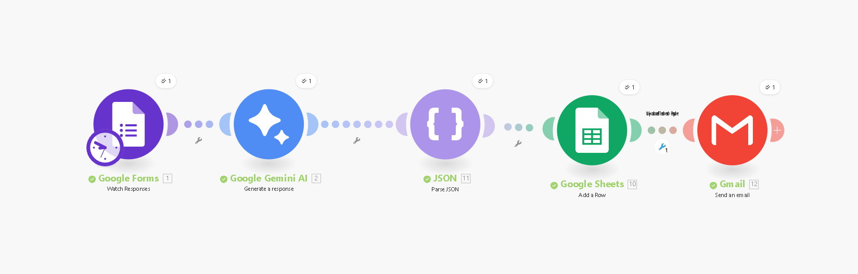
Workflow Diagram - Make Scenario
Make Scenario Workflow Link:
https://us2.make.com/public/shared-scenario/X4vjxrZE6FC/make-automation-workflow-setup

Slide 6
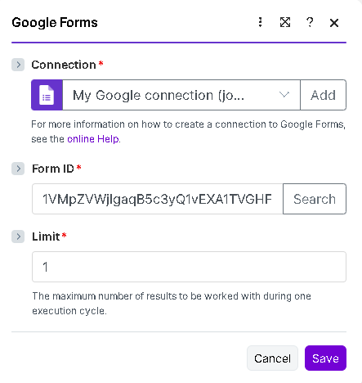
Google Forms - Make Settings
Make Scenario Workflow Link:
https://us2.make.com/public/shared-scenario/X4vjxrZE6FC/make-automation-workflow-setup

Slide 7
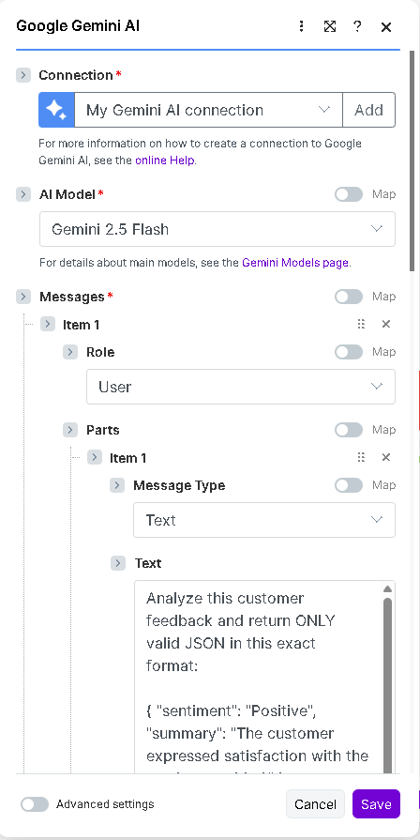
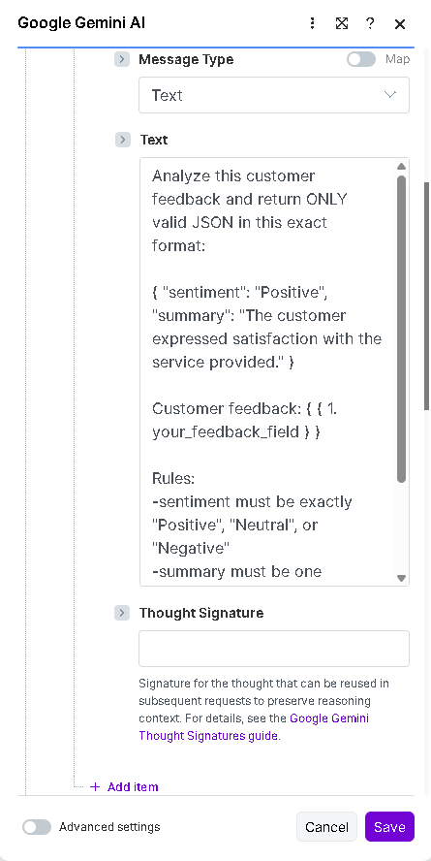
Google Gemini AI - Make Settings
Make Scenario Workflow Link:
https://us2.make.com/public/shared-scenario/X4vjxrZE6FC/make-automation-workflow-setup

Slide 8
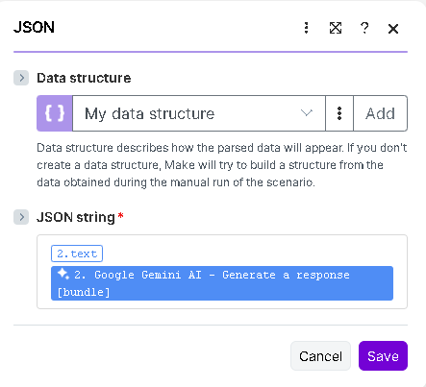
Parse JSON - Make Settings
Make Scenario Workflow Link:
https://us2.make.com/public/shared-scenario/X4vjxrZE6FC/make-automation-workflow-setup

Slide 9
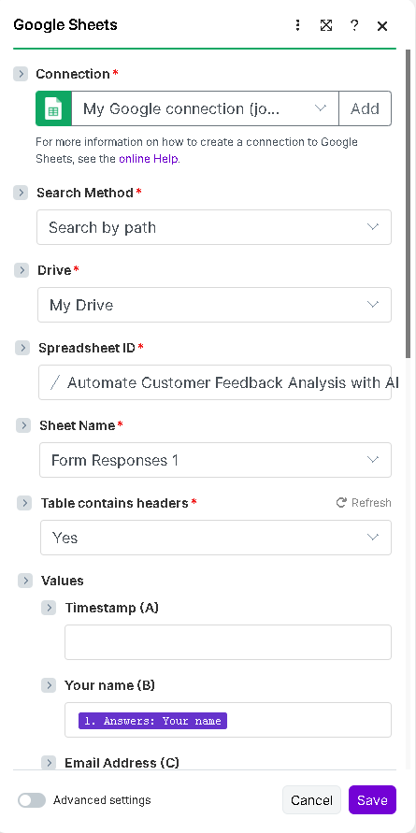
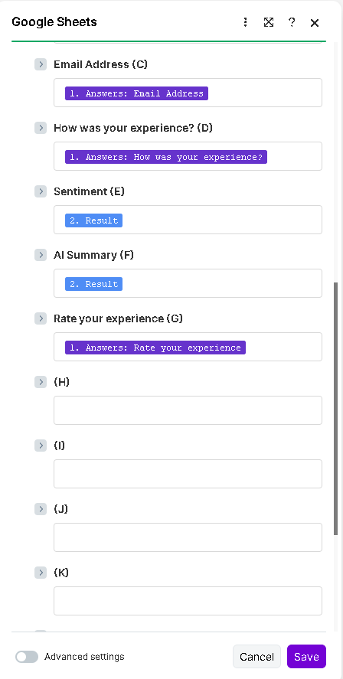
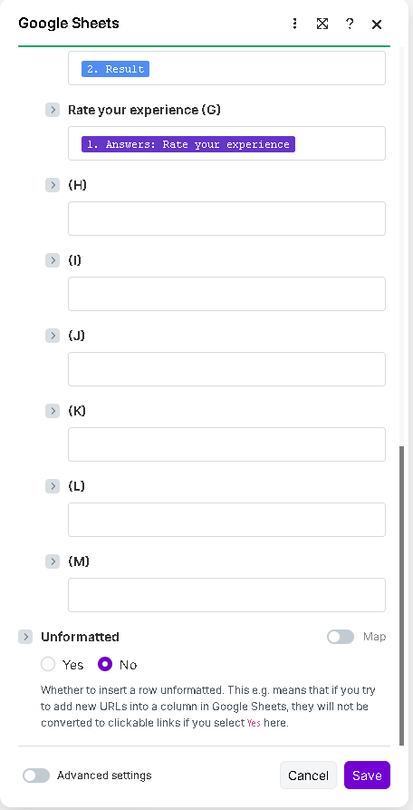
Google Sheets - Make Settings
Make Scenario Workflow Link:
https://us2.make.com/public/shared-scenario/X4vjxrZE6FC/make-automation-workflow-setup

Slide 10
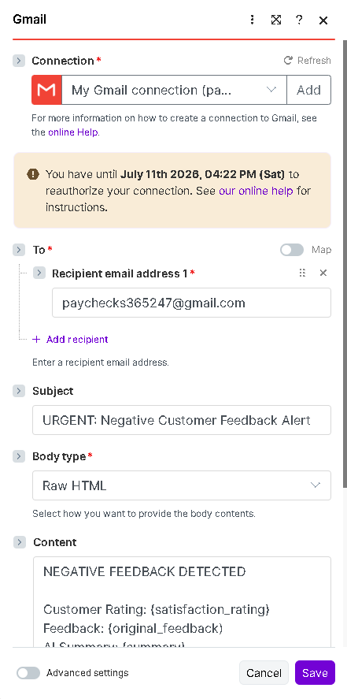
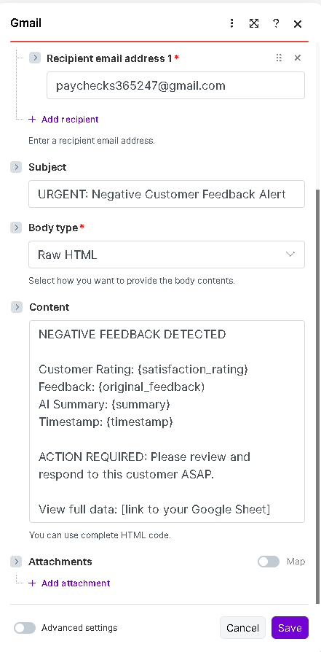
Gmail - Make Settings
Make Scenario Workflow Link:
https://us2.make.com/public/shared-scenario/X4vjxrZE6FC/make-automation-workflow-setup

Slide 11
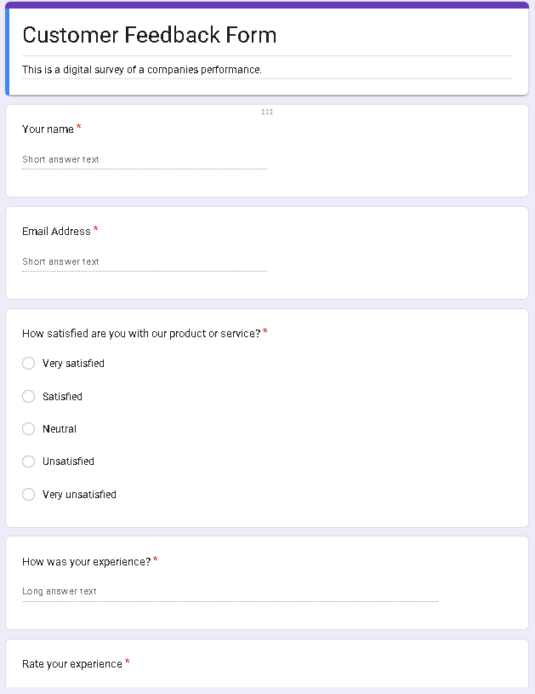
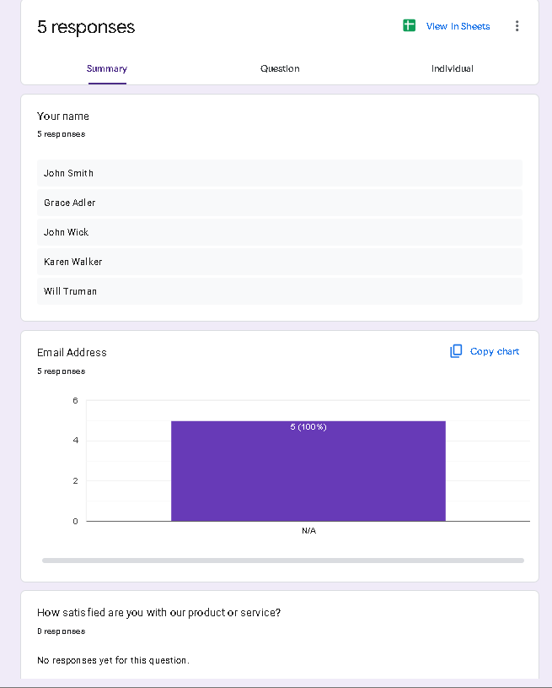
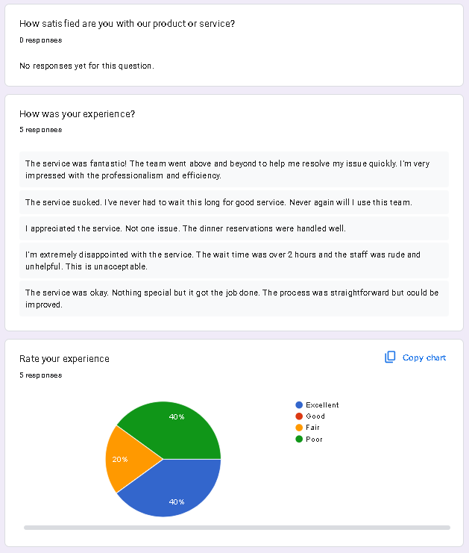
Workflow in action - Google Forms
Google Forms Workflow Link:
https://docs.google.com/forms/d/e/1FAIpQLSd02PaSTJWO-fK-B1vj_9X4GKQpuZez_5qOb5T54Gc7r1RPVA/viewform?usp=sharing&ouid=106084722717281723637

Slide 12
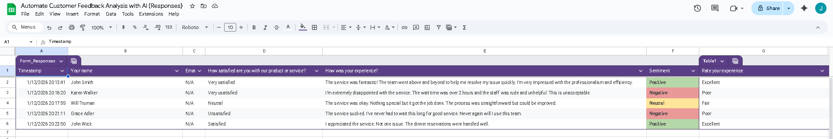
Workflow in action - Google Sheets
Google Sheets Workflow Link:
https://docs.google.com/spreadsheets/d/1Sev-GDaID2wKyfLfb0gWg0zEC84BXZWKPNamx9WNWsE/edit?usp=sharing

Slide 13
Ways to Improve Current Workflow
Using “Slack AI” could automate status updates and reminders to ensure everyone stays informed, minimizing miscommunication and burnout.
Using “UiPath” for data entry, email management, and appointment scheduling can free up time for strategic work.

